Slide 1
Process Control
Course II
Lecture 10
Optimum Controller Setting

Slide 2
Optimum Controller Setting
The complexity of high order system makes the selection of controller parameters (Kc, I and R)is difficult. So the controller tuning is often performed using one of the following two methods: Zeigler-Nichols and Cohen-Coon.
This method is also called a closed-loop method. The approach of this method is illustrated in the following steps:
1- Ziegler- Nichols Method (Z-N)
1- Remove the integral and derivative modes of the controller by setting $R→0 and I→∞.$ Then the controller becomes proportional.
$G_{c}\left(s\right)=K_{c}\left(1+RS+\frac{1}{IS}\right)$ $G_{c}\left(s\right)=K_{c}$

Slide 3
2- Select a small value of the proportional gain Kc
3- Disturb the system with a step change.
4- Observe the transient response of the output variable.
5 - If the system decays , then select a higher value of Kc and a gain observe the response of the system
6 - Continue increase the gain Kc in small steps until the response first exhibits sustained oscillation.
Tc
y
0
t

Slide 4
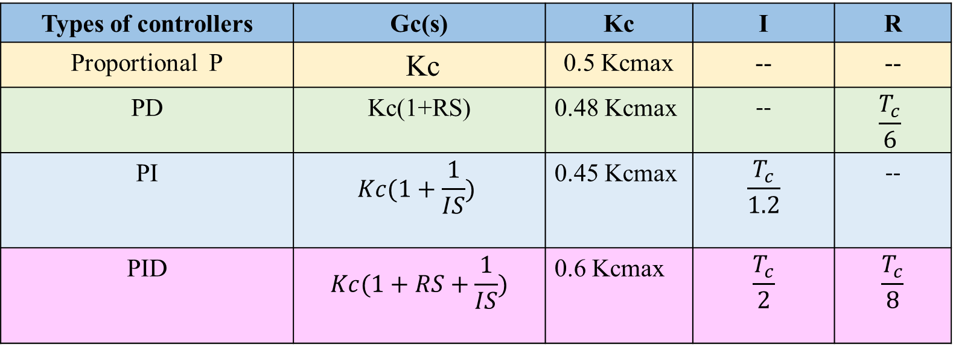
7 - The value of the gain Kc and period of oscillation Tc that correspond to the sustained oscillation are the ultimate gain (Kcmax) and ultimate period of oscillation Tc.
8 - From The value of the gain Kc and period of oscillation Tc we can predict the optimum values of the controller parameters using Ziegler-Nichols rules as shown in the Table below.
Types of controllers | Gc(s) | Kc | I | R
Proportional P | Kc | 0.5 Kcmax | -- | --
PD | Kc(1+RS) | 0.48 Kcmax | -- | $$\frac{T_{c}}{6}$$
PI | $$Kc(1+\frac{1}{IS})$$ | 0.45 Kcmax | $$\frac{T_{c}}{1.2}$$ | --
PID | $$Kc(1+RS+\frac{1}{IS})$$ | 0.6 Kcmax | $$\frac{T_{c}}{2}$$ | $$\frac{T_{c}}{8}$$

Slide 5
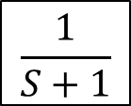
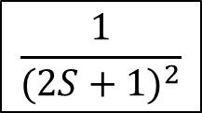
Example 1
Consider the closed-loop system shown in block diagram below.
$Ysp$(s)
+
$Yo$(s)
∑
$K_{c}(1+RS+\frac{1}{IS}$ )
$$\frac{1}{(2S+1)^{2}}$$
_
$$\frac{1}{S+1}$$
1- Find the optimum values of the controller parameters (Kc , R and I) using Ziegler-Nichols method.
2- Test the stability.

Slide 6
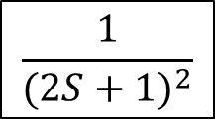
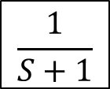
Solution
$$Controller: G_{c}\left(s\right)=K_{c}\left(1+RS+\frac{1}{IS}\right)$$
(1). Ziegler-Nichols method
+
$Ysp$(s)
$Yo$(s)
∑
$$\frac{1}{(2S+1)^{2}}$$
$$R→0 , I→∞$$
$$K_{c}$$
_
$$∴ G_{c}\left(s\right)=K_{c}$$
Now, we will use Routh method to find Kcmax
$$\frac{1}{S+1}$$
$$1+GG_{m}=0$$
$$1+K_{c}\left(\frac{1}{{\left(2S+1\right)}^{2}\left(S+1\right)}\right)=0$$
$$4S^{3}+8S^{2}+5S+1+K_{c}=0$$

Slide 7
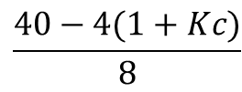
$$4S^{3}+8S^{2}+5S+1+K_{c}=0$$
n
1
$$4$$
$$5$$
$$0$$
2
$$8$$
$$1+Kc$$
$$0$$
3
$$\frac{40−4(1+Kc)}{8}$$
$$0$$
4
$$1+Kc$$
$$0$$
$$\frac{40−4(1+Kc)}{8}=0$$
$$K_{c max}=9$$

Slide 8
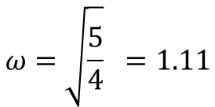
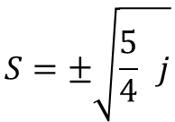
To find ω and Tc
$$8S^{2}+1+K_{c}=0$$
$$8S^{2}+10=0$$
$$S=±\sqrt{\frac{5}{4} j}$$
$$ω=\sqrt{\frac{5}{4}} =1.11$$
$$ω=\frac{2π}{T_{c}}$$
$$T_{c}=\frac{2π}{ω}= \frac{2π}{1.11}=5.66$$

Slide 9
Using Ziegler – Nichols method
$K_{c}=0.6 K_{ max}$= 0.6(9) = 5.4
$I=\frac{T_{c}}{2}= \frac{5.66}{2}=2.83$
$R=\frac{T_{c}}{8}= \frac{5.66}{8}=0.707$
$$Controller: G_{c}\left(s\right)=K_{c}\left(1+RS+\frac{1}{IS}\right)$$
$$G_{c}\left(s\right)=5.4\left(1+0.707S+\frac{1}{2.83 S}\right)$$

Slide 10
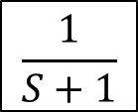
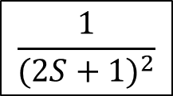
(2). Stability
$Ysp$(s)
+
$Yo$(s)
$$1+GG_{m}=0$$
$$5.4\left(1+0.707S+\frac{1}{2.83 S}\right)$$
$$\frac{1}{(2S+1)^{2}}$$
∑
_
$$\frac{1}{S+1}$$
$$1+5.4(1+0.707S+\frac{1}{2.83 S})\left(\frac{1}{{\left(2S+1\right)}^{2}\left(S+1\right)}\right)=0$$
$$4S^{4}+8S^{3}+8.816 S^{2}+6.4 S+1.9=0$$

Slide 11
$$4S^{4}+8S^{3}+8.8S^{2}+6.377S+1.9=0$$
n
1
$$4$$
$$8.8$$
$$1.9$$
$$0$$
2
$$8$$
$$6.377$$
$$0$$
3
$$5.61$$
$$1.9$$
$$0$$
4
$$3.66$$
$$0$$
5
$$1.9$$
$$0$$
The system is stable

Slide 12
2- Cohen-Coon Method (C-C )
This method is also called reaction curve method or open loop method in which the control action is removed from the controller by placing it in manual mode.
M
+
$Ysp$(s)
+
$Yo$(s)
∑
$$Gc$$
$$Gv$$
$$Gp$$
_
$$Gm$$
B
To recorder
Figure 1: splitting the controller from the closed loop.

Slide 13
Cohen – Coon approach
1- Switch the controller to manual mode. Split the controller from the closed loop.
2- Introduce a step change in the controller output M(s) that goes to the valve and record the transient response (B) as shown in Figure(1)
3- The response of the system (including the valve, the process and the measuring element ) is called the process reaction curve. This response will appear as S-shape as shown in Fig.2
y
Fig.2
0
Time

Slide 14
4- Draw the horizontal asymptote to the final response KA
y
K A
0
t

Slide 15
5- locate the inflection point on the response curve f , then draw a tangent to the curve from the inflection point (line ab in the figure below)
y
b
K A
0
a
t

Slide 16
6- Draw a vertical line from (b) to x-axis and locate point (c) as shown in figure below.
7- From the plot, calculate both; $τ and τ_{D}$as shown in Figure below.
y
b
K A
0
0
a
c
t
$$τ_{D}$$
$$τ$$

Slide 17
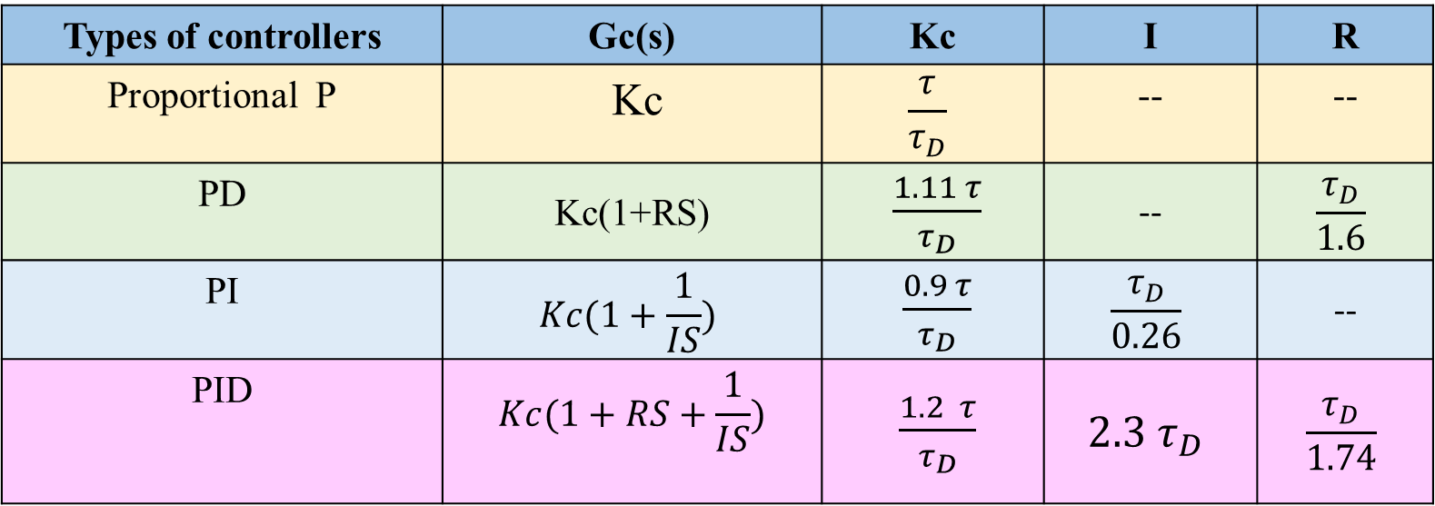
8- From values of $τ$ and $τ_{D}$ we can estimate the optimum values of the controller parameters ( Kc, R and I) as shown in the table below.
Types of controllers | Gc(s) | Kc | I | R
Proportional P | Kc | $$\frac{τ}{τ_{D}}$$ | -- | --
PD | Kc(1+RS) | $\frac{1.11 τ}{τ_{D}}$ | -- | $$\frac{τ_{D}}{1.6}$$
PI | $$Kc(1+\frac{1}{IS})$$ | $\frac{0.9 τ}{τ_{D}}$ | $$\frac{τ_{D}}{0.26}$$ | --
PID | $$Kc(1+RS+\frac{1}{IS})$$ | $\frac{1.2 τ}{τ_{D}}$ | $$2.3 τ_{D}$$ | $$\frac{τ_{D}}{1.74}$$

Slide 18
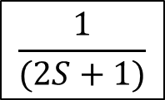
Example 2
Consider the closed loop shown below. In order to estimate the optimum values of the controller parameters using Cohen – Coon, A step change of value 7 affect the set point . The controller is set to manual mode and the transient response from the measuring element was recorded . The data is given in the Table below.
1- Plot the data to estimate the optimum parameters of the controller.
2- Test the stability.
$Ysp$(s)
+
$Yo$(s)
∑
$K_{c}(1+RS+\frac{1}{IS}$ )
$$\frac{1}{(2S+1)}$$
_
$$\frac{1}{S+1}$$
Time(min) | 0 | 5 | 10 | 15 | 20 | 25 | 30 | 35 | 40 | 45 | 50 | 55 | 60 | 65 | 70 | 75 | 80 | 85 | 90
Response | 0 | 0.09 | 0.12 | 0.2 | 0.5 | 1 | 2 | 3.2 | 4.2 | 5 | 5.5 | 6 | 6.4 | 6.6 | 6.8 | 6.9 | 6.97 | 6.99 | 7

Slide 19
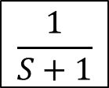
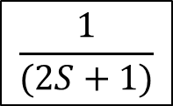
Solution
(1).
1- Set the controller to the manual mode as shown in the Figure below
Step change
M(s)
$Ysp$(s)
+
$Yo$(s)
∑
$K_{c}(1+RS+\frac{1}{IS}$ )
$$\frac{1}{(2S+1)}$$
_
$$\frac{1}{S+1}$$
B(s)
Response

Slide 20
2- Plot the given data

Slide 21
2- Plot the tangent and find both $τ and τ_{D}$
$$τ_{D}≈20 min$$
$$τ≈55−20=35 min$$
$$τ$$

Slide 22
3- Determine the parameters of the controller as stated by Cohen-Coon
$K_{c}=\frac{1.2 τ}{τ_{D}}=1.2 \left( \frac{35}{20} \right)=2.1$
$$I =2.3 τ_{D}=2.3 \left( 20 \right)=46$$
$$R=\frac{τ_{D}}{1.74}= \frac{20}{1.74}=11.5$$
$$The Controller is : G_{c}\left(s\right)=K_{c}\left(1+RS+\frac{1}{IS}\right)=2.1 (1+11.5 S+ \frac{1}{46 S})$$

Slide 23
(2). Stability
$$1+GG_{m}=0$$
$$1+2.1(1+11.5 S+\frac{1}{46 S})\left(\frac{1}{(2 S+1)\left(S+1\right)}\right)=0$$
$$2S^{3}+27.15 S^{2}+3.1 S+0.0456=0$$
n
1
$$2$$
$3$.1
$$0$$
2
$$27.15$$
$$0.0456$$
$$0$$
3
$3$.066
$$0$$
4
$0.045$6
$$0$$
The system is stable

Slide 24
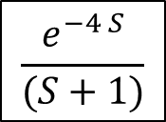
Homework
Q1. Consider the closed-loop system shown in block diagram below. Estimate the optimum value of the controller parameters using Ziegler – Nichol method. Test the stability of the system.
$Ysp$(s)
+
$Yo$(s)
∑
$K_{c}(1+RS+\frac{1}{IS}$ )
$$\frac{e^{−4 S}}{(S+1)}$$
_
Ans: $K_{c}=0.9 , I=2.81 , R=0.702 The system is stable$

Slide 25
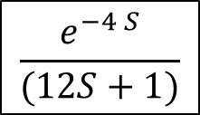
Q2. Consider the closed loop shown below. In order to estimate the optimum values of the controller parameters using Cohen – Coon, A step change of value 10 affect the set point . The controller is set to manual mode and the transient response from the measuring element was recorded . The data is given in the Table below.
1- Plot the data to estimate the optimum parameters of the controller(Kc, I and R)
2- Test the stability
+
Time | Response
0 | 0
5 | 0.06
15 | 0.15
25 | 2.1
30 | 5
35 | 8.1
40 | 9.2
45 | 9.5
50 | 9.6
55 | 9.7
60 | 9.8
65 | 9.98
$Ysp$(s)
$Yo$(s)
∑
$K_{c}(1+RS+\frac{1}{IS}$ )
$$\frac{e^{−4 S}}{(12S+1)}$$
_
Ans: $τ≈16 τ_{D}≈22 K_{c}=0.872 R=12.64 I=50.6 Stable$

Slide 26
Homework Q2/ Lecture 10

Slide 27
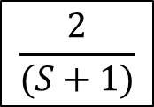
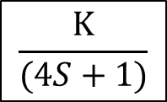
Q3. Consider the closed loop shown below. In order to estimate the optimum values of the controller parameters using Cohen – Coon, The controller is set to manual mode. A step change of value 10 is introduced at point M, and the transient response at point B was recorded . The data is given in the Table below.
1- Plot the data to estimate the optimum parameters of the controller(Kc, I and R)
2- Find the value of K
Time | Response
0 | 10
1 | 11
3 | 12
4 | 13
5 | 15
6 | 19
7 | 24
8 | 29
9 | 40
10 | 58
11 | 81
12 | 94
13 | 100
14 | 104
106 | 96
17 | 108
$Ysp$(s)
+
$Yo$(s)
$K_{c}(1+RS+\frac{1}{IS}$)
M
$$\frac{K}{(4S+1)}$$
∑
_
$$\frac{2}{(S+1)}$$
B

Slide 28
τ_{D} = 7.8
τ = 12.2 - 7.8 = 4.4

Slide 29
y(s)
$$y_{sp}$$
+
$$2(1+\frac{1}{I})$$
$$\frac{1}{(S+1)^{2}}$$
$$\sum{1}$$
-
$$\frac{1}{6S−1}$$

Slide 30
Thank you for your attention
Any ?

